Slide 1
Conditional Execution: If Statements
By Rachael Sera
For Junior Knights

Slide 2
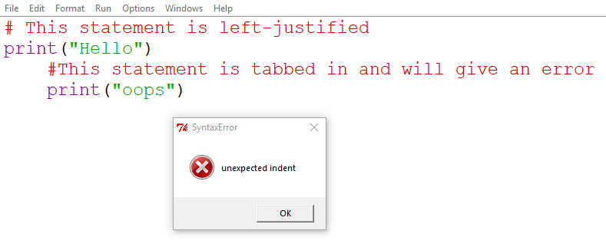
Indentaiton
Indentation is important in Python
It is used to group lines of code together
Inappropriately aligning lines will produce errors
So far, all our code has been left-justified
We’re about to learn some statements where indenting is appropriate

Slide 3
Conditional Execution: motivation
So far, our programs do the same operations every time we run them
Conditional execution allows us to perform different actions based on conditions
We use the “if-statement” to execute code if a condition is true (and not execute the code if it’s not true)

Slide 4
Boolean Expressions
Eponym: George Boole, mathmetician
Statements that are either true of false
Format: <operand> <operator> <operand>
Operand: “the quantity on which an operation is to be done,” usually a value
Operator: a relational operator (see next slide)
Notes:
When we have 2+3, 2 and 3 are the operands and + is the operator. That expression evaluates to 5. Boolean expressions will evaluate to true or false.

Slide 5
Relational Operators
== equal to
!= not equal to
> greater than
>= greater than or equal to
< less than
<= less than or equal to

Slide 6
Boolean Expression Examples
Are these expressions true or false?
5 == 5
5 == 4
5 > 4
5 < 4
5 != 5
5 != 4
5 >=4
5 <= 4
5 <= 5
4 > 5
4 < 5
4 <= 5

Slide 7
If-Statement
The if-statement will execute code if a condition is true (and not execute the code if it’s not true)
Indentation is used to group lines of code together
Code that is indented under the if-statement is part of the if-statement and is what will or won’t be executed based on whether the condition is true or not

Slide 8
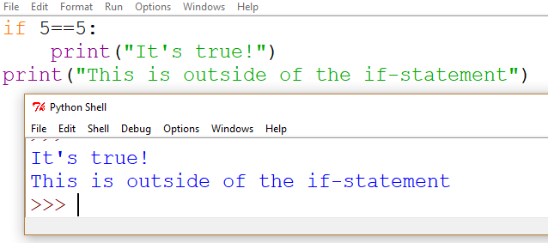
If-statement Example
Everything indented under the if-statement will execute only if the condition is true (in this example it is)
Anything left-justified is outside of the if-statement and will execute regardless, like our programs before
You can have multiple lines inside the if-statement

Slide 9
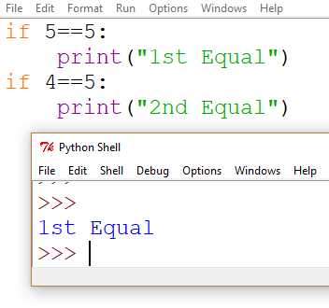
If-statement Example
The first statement is true, so “1st Equal” prints
But the second statement is not true, so “2nd Equal” does not print

Slide 10
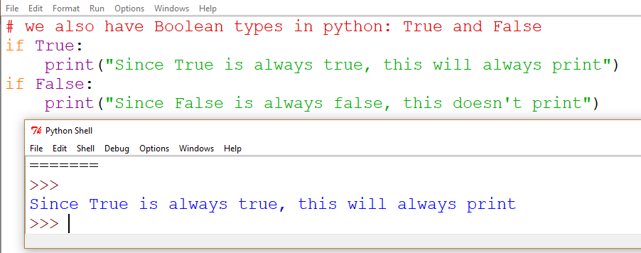
Boolean data type
This is to illustrate that if-statements work by evaluating a condition and to introduce the Boolean type

Slide 11
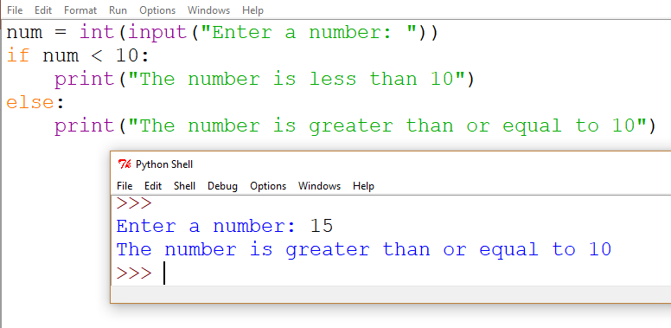
Else
Use else to make something “else” happen when the statement is false

Slide 12
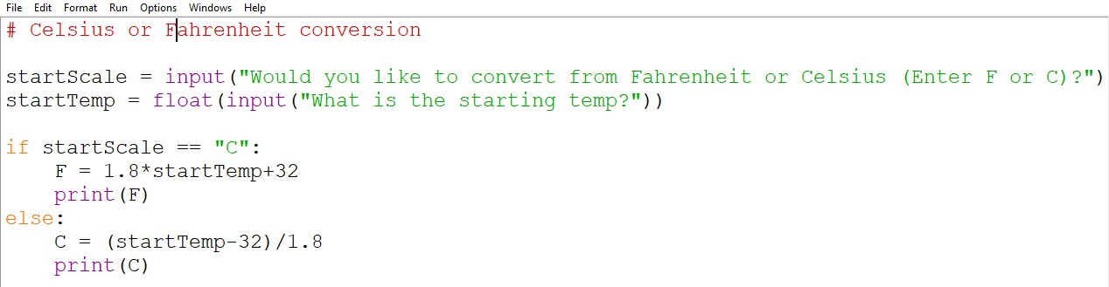
Temperature Conversion IF/Else Example
Notes:
Note, string inputs ARE case sensitive (so “C” is not equal to “c”)

Slide 13
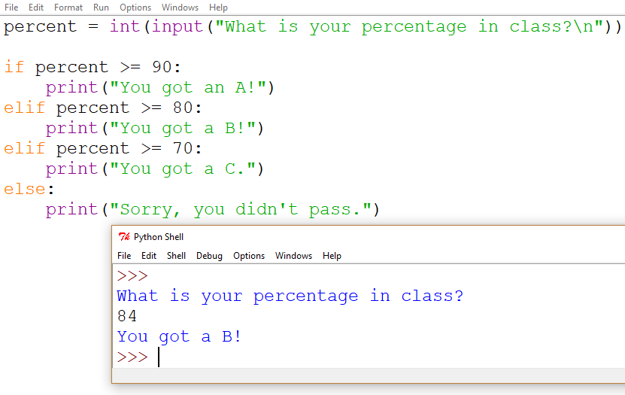
Elif
“Elif” is like “else” but instead of simply catching the opposite of the “if” condition, it can check for other, specific conditions
The first condition that is true will execute, and the rest will be skipped
The way this is structured, order matters. If percent >= 90, then we print, and we don’t check to see if it’s also >= 80.
If we move one of the other cases up, it will give misleading output.
Remove the “el” and then multiple statements can print

Slide 14
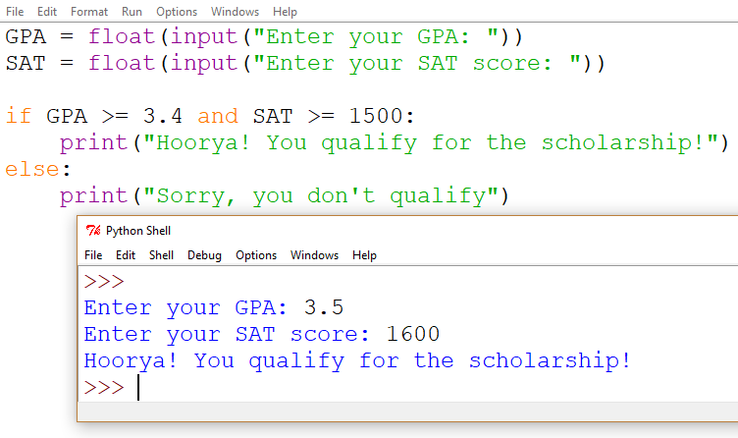
AND
Use “and” when multiple conditions are required

Slide 15
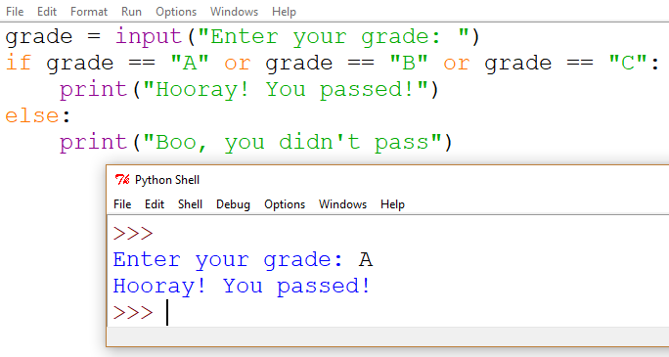
OR
Use “or” when only one (at least) of multiple conditions should cause the code to execute

